Slide 1


HOUSTON, TEXAS
MSAIS 5302 - AI & Machine Learning Final Presentation
Mitaali Dayal
Predicting tomorrow's
air quality.
A machine learning project that forecasts the next-day Air Quality Index category for Houston using historical pollution and weather data.
End-to-end pipeline · Multi-class classification

Slide 2




THE PROBLEM
Why predict tomorrow's air?
Today's AQI is already public. Tomorrow's hasn't happened yet — and that's the number people actually need to make decisions.
Parents
Schools
City teams
Athletes
Should my asthmatic child play outside tomorrow?
Do we hold tomorrow's outdoor PE class?
Should we issue a public-health advisory?
Is tomorrow's morning run safe to do outside?
Same forecast, four different decisions. The model exists to help all of them.
Houston AQI Forecast · Next-day classifier
2 / 11

Slide 3

IN THE NEWS
Houston's air quality keeps making headlines.
Recent reporting on the same problem we're trying to forecast — from rankings, ozone alerts, refinery emissions, and wildfire smoke.
AMERICAN LUNG ASSOCIATION · STATE OF THE AIR 2025
NEWSWEEK · 2024
HOUSTON PUBLIC MEDIA · AUG 2024
Houston metro ranked 7th most polluted U.S. city for ozone.
Houston saw nearly 50 ozone action days in 2024.
"Dirty Dozen" report names city's 12 worst air polluters.
HOUSTON LANDING · MAY 2024
TEXAS TRIBUNE · MAR 2024
WHY THIS PROJECT EXISTS
Wildfire smoke from Central America blankets Houston.
Air monitors fail Latino communities near the Ship Channel.
Houston has a real, recurring air quality problem. A reliable next-day forecast helps families and schools plan ahead.
Houston AQI Forecast · Next-day classifier
3 / 11

Slide 4
THE TARGET
Three categories, one prediction.
The Air Quality Index runs 0–500. We group the relevant range into three actionable classes.
0 – 50
Good
Air is clean. Go outside, exercise, breathe deep.
51 – 100
Moderate
Acceptable for most. Some sensitive folks may notice it.
101+
Unhealthy for sensitive groups
Asthmatics, kids, elderly, people with heart conditions should reduce outdoor exertion.
We frame this as multi-class classification: given today, predict which class tomorrow falls into.
Houston AQI Forecast · Next-day classifier
4 / 11

Slide 5


THE DATA
Two public sources, six years.
Both sources pulled directly from public APIs — no manual downloads, fully reproducible.
POLLUTION
WEATHER
EPA Air Quality System
Open-Meteo Archive
Daily AQI values for Harris County, TX (Houston). Includes the dominant pollutant — PM2.5, ozone, PM10, NO₂.
Daily temperature, humidity, wind speed, and precipitation at Houston's coordinates.
Joined on date
6 years
2,192 days
Houston
Two domains
of daily history
of observations
Harris County, TX
pollution + weather
Houston AQI Forecast · Next-day classifier
5 / 11

Slide 6




THE PIPELINE
How we got from raw data to a forecast.
01
02
03
04
05
06
Load
>
Clean
>
Engineer
>
Train
>
Tune
>
Deploy
Pull EPA + weather data via public APIs and merge on date.
Reindex to a continuous daily series; fill any gaps carefully.
Build lag, rolling, trend, weather, calendar, and pollutant features.
Three model families compared: linear, random forest, gradient boosting.
Hyperparameter search with time-series-aware cross-validation.
Wrap the model in a prediction function with a watch-tier safety net.
Each step was validated honestly: time-based splits, no leakage, diagnostics before declaring success.
Houston AQI Forecast · Next-day classifier
6 / 11

Slide 7
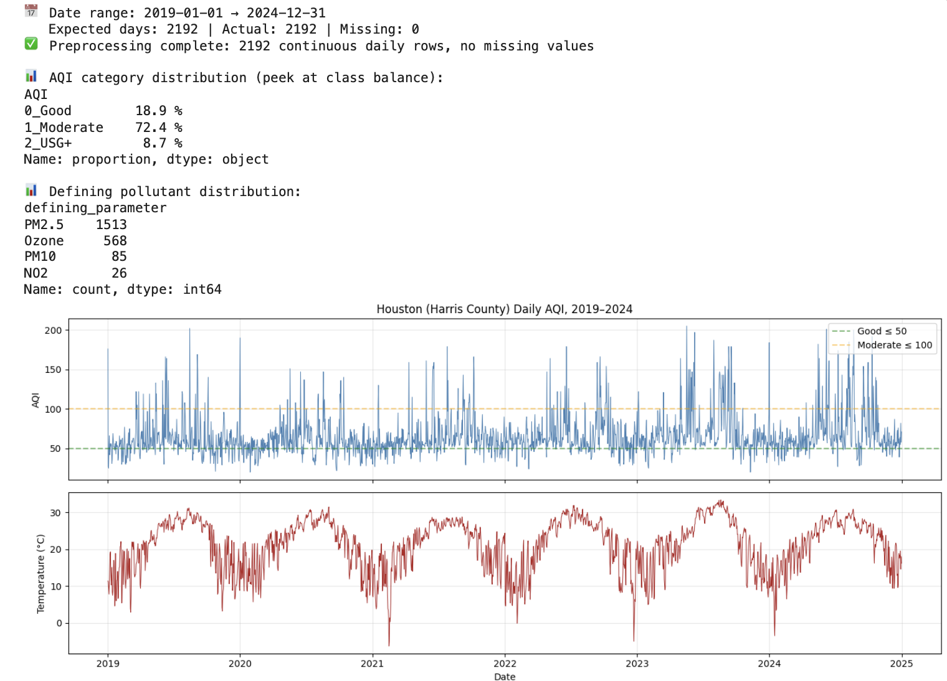
DATA PREPROCESSING
Transforming raw data into a usable format
Sorted all records by date.
Checked for missing daily records.
Created a continuous daily dataset.
Filled weather gaps using forward/backward fill. Interpolated AQI values if gaps existed.
AQI changes over time, while temperature shows seasonal patterns. Most days are Moderate, but harmful USG+ days still appear as spikes.
7/11

Slide 8
THE MODELS
Three model families, three different bets.
We compared models with very different assumptions to see which best fits this problem.
BASELINE
ENSEMBLE
BOOSTING
Logistic Regression
Random Forest
LightGBM
Linear decision boundaries.
Many independent decision trees.
Trees that learn from each other's mistakes.
A simple, interpretable starting point. Fast to train and easy to reason about — perfect for setting a floor.
Captures nonlinear interactions automatically. Robust to noise and outliers, hard to overfit catastrophically.
Sequentially fits trees to fix prior errors. Usually the strongest performer on structured tabular data.
Each one tells us something different — together they bracket what's actually possible on this problem.
Houston AQI Forecast · Next-day classifier
8 / 11

Slide 9




FEATURE ENGINEERING
What does the model see?
Goal is to capture patterns affecting air quality
History
Trend
Yesterday, 2-day, and 7-day AQI
3- and 7-day rolling averages
Volatility over the past week
Day-over-day AQI change
Multi-day momentum signals
Is air quality rising or falling?
Weather
Calendar
Temperature, humidity, wind, rain
Yesterday's conditions as lags
Hot + still air interaction term
Day of week, weekend flag
Cyclical month encoding
Day-of-year for seasonality
Houston AQI Forecast · Next-day classifier
9/11

Slide 10
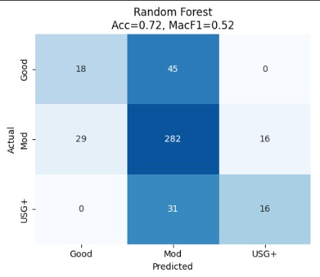
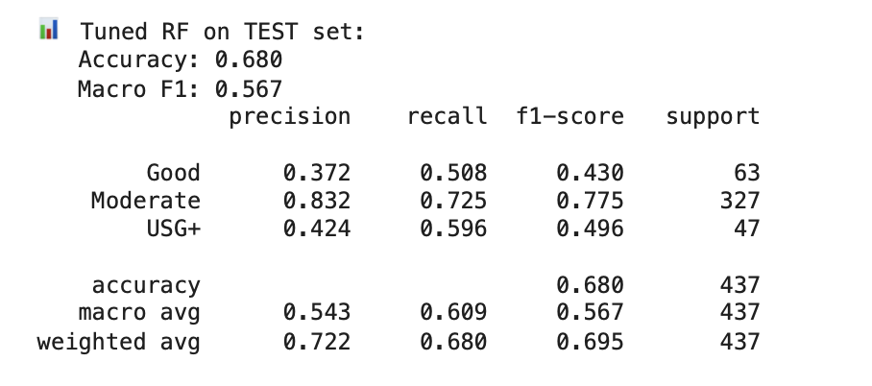
RESULTS AND INSIGHTS
Model Improvements:
Hyperparameter tuning improved Macro F1 to ~ 0.57
Better detection of USG+ (harmful days)
Slight drop in overall accuracy
Used regularized RF + threshold tuning
Balanced accuracy and risk detection
Model Performance
We compared models with very different assumptions to see which best fits this problem.
Winner
Random Forest
Random Forest performed best
Accuracy ≈ 72–74%
Macro F1 ≈ 0.52
Key Insights:
Model predicts “Moderate” very well
Struggles with USG+ (harmful days)
Accuracy alone is misleading due to class imbalance
Houston AQI Forecast · Next-day classifier
10/11

Slide 11
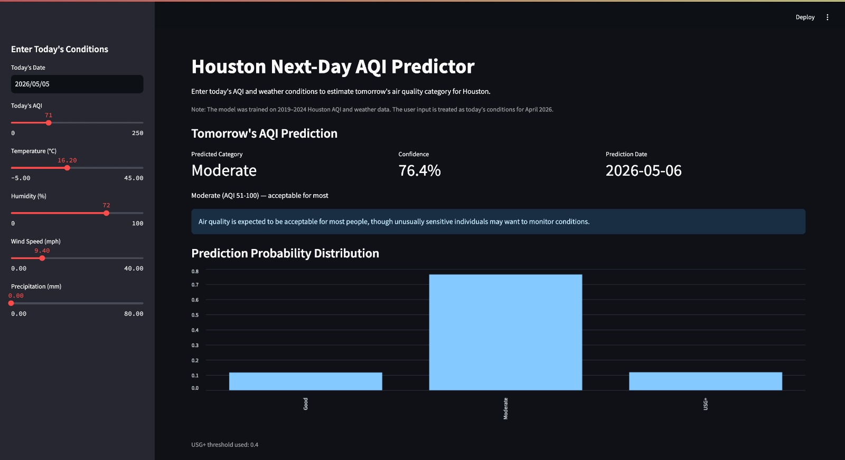
STREAMLIT DASHBOARD
Interactive Streamlit Dashboard
Provides an intuitive interface for users to explore air quality predictions and risk levels.
Houston AQI Forecast · Next-day classifier
11/11

Slide 12
MAKING IT BETTER
Key Considerations & Model Insights
Real-world data is naturally imbalanced Most days are “Moderate,” fewer harmful days
Model focuses on detecting critical USG+ cases Prioritizing safety over perfect accuracy
Accuracy alone is not sufficient Used Macro F1 and recall for better evaluation
Balanced performance achieved through tuning Tradeoff between overall accuracy and risk detection
Goal is to build a model that is reliable for real-world decision making
Houston AQI Forecast · Next-day classifier

Slide 13
Thank you.
Houston AQI Forecast · Next-day classifier

